Slide 1
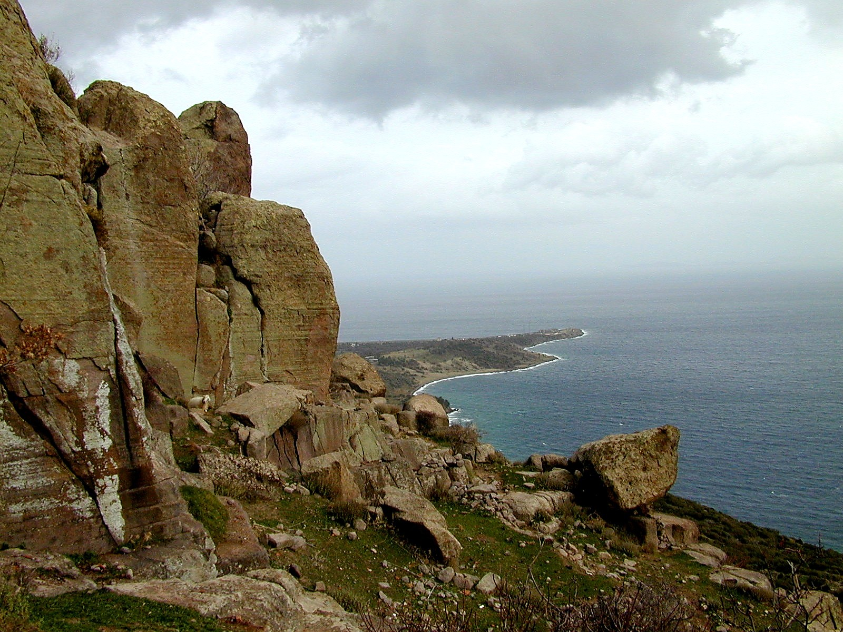
1 Peter 5
Assos cliffs [in the province of Asia]. This photo is from the collection "Pictorial Library of Bible Lands, volumes 1-10," © 2006 by Todd Bolen, bibleplaces.com.

Slide 2
1 Peter 5.1-4: So as your fellow elder and a witness of Christ's sufferings and as one who shares in the glory that will be revealed, I urge the elders among you: ²Give a shepherd's care to God's flock among you, exercising oversight not merely as a duty but willingly under God's direction, not for shameful profit but eagerly. ³And do not lord it over those entrusted to you, but be examples to the flock. ⁴Then when the Chief Shepherd appears, you will receive the crown of glory that never fades away.

Slide 3
1 Peter 5.1: So as your fellow elder and a witness of Christ's sufferings and as one who shares in the glory that will be revealed, I urge the elders among you...

Slide 4
1 Peter 5.1: So as your fellow elder and a witness of Christ's sufferings and as one who shares in the glory that will be revealed, I urge the elders among you...

Slide 5
1 Peter 5.2: Give a shepherd's care to God's flock among you, exercising oversight not merely as a duty but willingly under God's direction, not for shameful profit but eagerly.
To shepherd / to oversee = to protect & help
† Support with prayer † Provide care
† Administrate † Equip for ministry
† Ensure spiritual health † Ensure spiritual growth
† Protect doctrine † Promote good teaching

Slide 6
1 Peter 5.2: Give a shepherd's care to God's flock among you, exercising oversight not merely as a duty but willingly under God's direction, not for shameful profit but eagerly.

Slide 7
1 Peter 5.3-4: And do not lord it over those entrusted to you, but be examples to the flock. ⁴Then when the Chief Shepherd appears, you will receive the crown of glory that never fades away.

Slide 8

1 Peter 5.3-4: And do not lord it over those entrusted to you, but be examples to the flock. ⁴Then when the Chief Shepherd appears, you will receive the crown of glory that never fades away.

Slide 9
1 Peter 5.5: In the same way, you who are younger, be subject to the elders. And all of you, clothe yourselves with humility toward one another, because God opposes the proud but gives grace to the humble.
Be subject to the elders:
Seek to learn, understand, agree with their teaching
Accept their counsel and correction
Participate in their training and serve in ministries
Accept their administrative decisions

Slide 10
1 Peter 5.5: In the same way, you who are younger, be subject to the elders. And all of you, clothe yourselves with humility toward one another, because God opposes the proud but gives grace to the humble.

Slide 11
1 Peter 5.6-7: And God will exalt you in due time, if you humble yourselves under his mighty hand ⁷by casting all your cares on him because he cares for you.

Slide 12
1 Peter 5.6-7: And God will exalt you in due time, if you humble yourselves under his mighty hand ⁷by casting all your cares on him because he cares for you.

Slide 13
1 Peter 5.6-7: And God will exalt you in due time, if you humble yourselves under his mighty hand ⁷by casting all your cares on him because he cares for you.
1 Peter 5.6-7 NASB: Therefore humble yourselves under the mighty hand of God, that He may exalt you at the proper time, ⁷casting all your anxiety on Him, because He cares for you.
while casting?
and cast?
for the purpose
of casting?
by casting?

Slide 14
1 Peter 5.8-9: Be sober and alert. Your enemy the devil, like a roaring lion, is on the prowl looking for someone to devour. ⁹Resist him, strong in your faith, because you know that your brothers and sisters throughout the world are enduring the same kinds of suffering.

Slide 15
1 Peter 5.8-9: Be sober and alert. Your enemy the devil, like a roaring lion, is on the prowl looking for someone to devour. ⁹Resist him, strong in your faith, because you know that your brothers and sisters throughout the world are enduring the same kinds of suffering.

Slide 16
1 Peter 5.10-11: And, after you have suffered for a little while, the God of all grace who called you to his eternal glory in Christ will himself restore, confirm, strengthen, and establish you. ¹¹To him belongs the power forever. Amen.

Slide 17
1 Peter 5.12: Through Silvanus, whom I know to be a faithful brother, I have written to you briefly, in order to encourage you and testify that this is the true grace of God. Stand fast in it.

Slide 18
1 Peter 5.12: Through Silvanus, whom I know to be a faithful brother, I have written to you briefly, in order to encourage you and testify that this is the true grace of God. Stand fast in it.
...ταύτην εἶναι ἀληθῆ χάριν τοῦ θεοῦ εἰς ἣν στῆτε = this is the true grace of God in which you must stand firm!

Slide 19
1 Peter 5.13-14: The church in Babylon, chosen together with you, greets you, and so does Mark, my son. ¹⁴Greet one another with a loving kiss. Peace to all of you who are in Christ.

Slide 20
1 Peter 5.13-14: The church in Babylon, chosen together with you, greets you, and so does Mark, my son. ¹⁴Greet one another with a loving kiss. Peace to all of you who are in Christ.

Slide 21
1 Peter 5
Assos cliffs [in the province of Asia]. This photo is from the collection "Pictorial Library of Bible Lands, volumes 1-10," © 2006 by Todd Bolen, bibleplaces.com.

